Slide 1
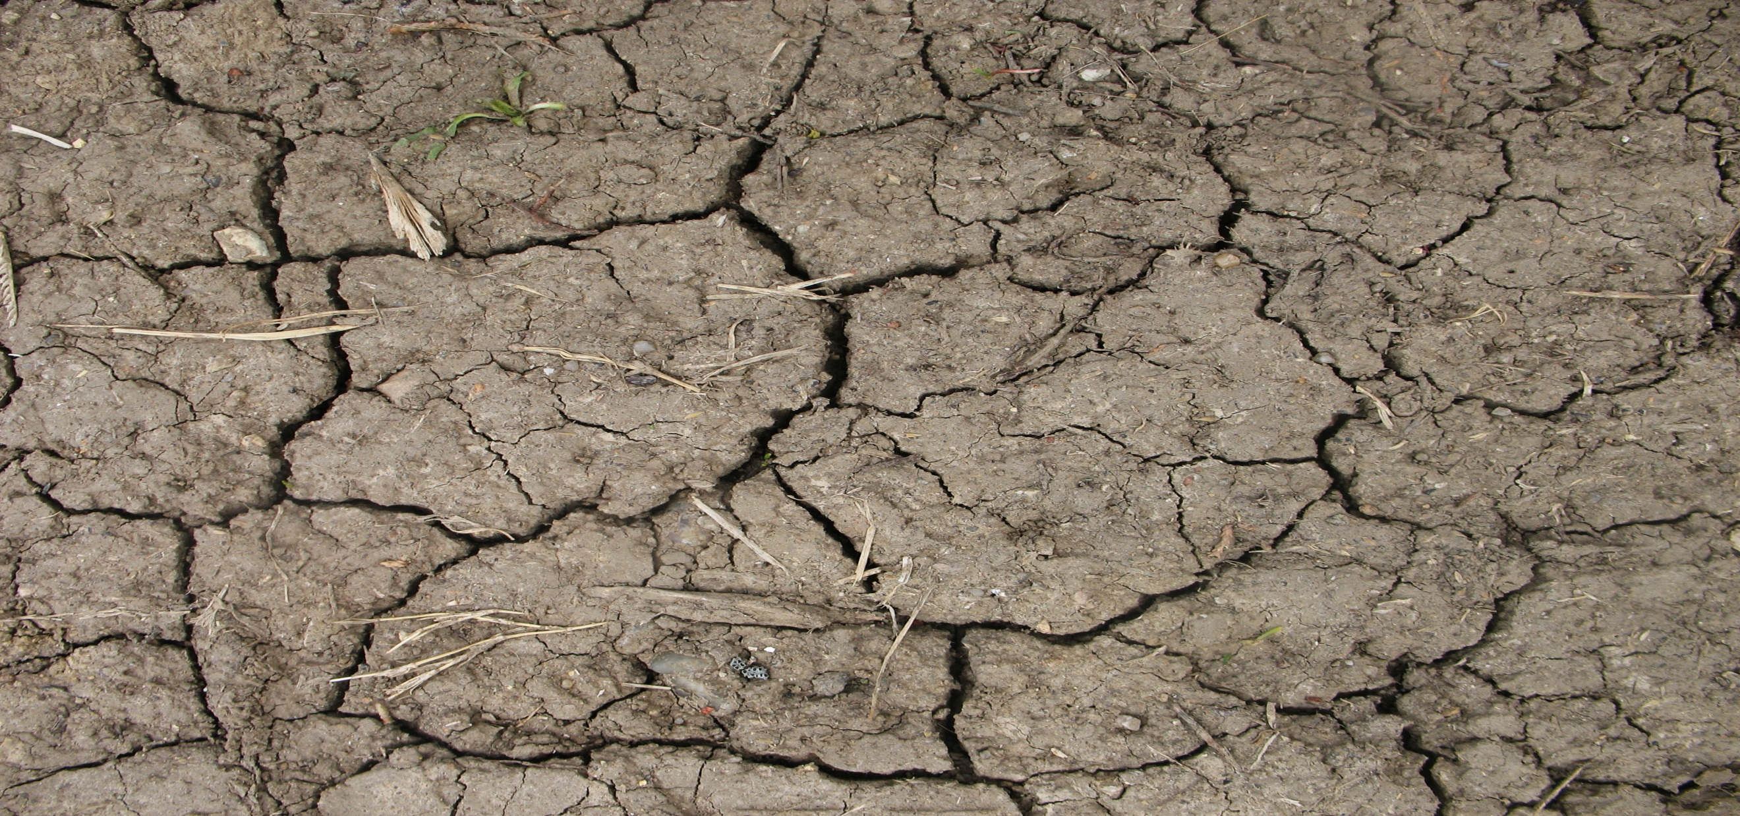
The Last Mile of the Way
Matthew 27:32-37

Slide 2
Matthew 27:32-37
32 Now as they came out, they found a man of Cyrene, Simon by name. Him they compelled to bear His cross. 33 And when they had come to a place called Golgotha, that is to say, Place of a Skull, 34 they gave Him sour wine mingled with gall to drink. But when He had tasted it, He would not drink.

Slide 3
Matthew 27:32-37
35 Then they crucified Him, and divided His garments, casting lots, that it might be fulfilled which was spoken by the prophet: "They divided My garments among them, And for My clothing they cast lots."36 Sitting down, they kept watch over Him there. 37 And they put up over His head the accusation written against Him: THIS IS JESUS THE KING OF THE JEWS

Slide 4
The Journey to the Cross
The people followed Christ and mourned for Him
26 Now as they led Him away, they laid hold of a certain man, Simon a Cyrenian, who was coming from the country, and on him they laid the cross that he might bear it after Jesus.27 And a great multitude of the people followed Him, and women who also mourned and lamented Him. Luke 23:26-27

Slide 5
The Journey to the Cross
Christ speaks to the people following Him
But Jesus, turning to them, said, " Daughters of Jerusalem, do not weep for Me, but weep for yourselves and for your children. 29 For indeed the days are coming in which they will say, ' Blessed are the barren, wombs that never bore, and breasts which never nursed! ' 30 Then they will begin 'to say to the mountains, " Fall on us!" and to the hills, " Cover us!" '

Slide 6
The Journey to the Cross
Christ speaks to the people following Him
31 For if they do these things in the green wood, what will be done in the dry?"32 There were also two others, criminals, led with Him to be put to death.
Luke 23:28-32

Slide 7
The Crucifixion
The Process
1. The victim would be placed on the cross, with each arm spread out, and his legs placed together.
a. Anatomically, the wrist is considered part of the hand.
b. The nails, would have been place in the center of the wrist
to prevent the nail from coming out of the hand.
c. Because of the nerve in the wrist, any pressure on the
wrist would of caused tremendous pain.

Slide 8
The Crucifixion
The difficulties of the cross
1. A person couldn’t simply breathe on the cross normally. Because you would be literally hanging by the nails in the wrist and resting on the nail in your feet.
2.For this reason, the victim would have to lift themselves up, causing great pain in the wrist, and breathe out by lowering themselves down on the nail in their feet.

Slide 9
The Crucifixion
The difficulties of the cross
3. Therefore, the person would be alternating between terrible pain and terrible pain.
4. In the midst of unbearably pain, what did Christ say?
Then Jesus said, " Father, forgive them, for they do not know what they do.“
Luke 23:34a

Slide 10
Events while on the Cross
The Soldiers cast lots for His clothing
…And they divided His garments and cast lots.
Luke 23:34b

Slide 11
Events while on the Cross
A criminal and paradise
Then one of the criminals who were hanged blasphemed Him, saying, " If You are the Christ, save Yourself and us."40 But the other, answering, rebuked him, saying, "Do you not even fear God, seeing you are under the same condemnation? 41 And we indeed justly, for we receive the due reward of our deeds; but this Man has done nothing wrong."

Slide 12
Events while on the Cross
A criminal and paradise
42 Then he said to Jesus, " Lord, remember me when You come into Your kingdom."43 And Jesus said to him, " Assuredly, I say to you, today you will be with Me in Paradise.“
Luke 23:39-43

Slide 13
Events while on the Cross
Jesus’ care for Mary
When Jesus therefore saw His mother, and the disciple whom He loved standing by, He said to His mother, " Woman, behold your son!" 27 Then He said to the disciple, " Behold your mother!" And from that hour that disciple took her to his own home.
John 19:26-27

Slide 14
Events while on the Cross
Darkness covers the land
Now when the sixth hour had come, there was darkness over the whole land until the ninth hour.
Mark 15:33

Slide 15
Events while on the Cross
Jesus forsaken?
And about the ninth hour Jesus cried out with a loud voice, saying, " Eli, Eli, lama sabachthani?" that is, " My God, My God, why have You forsaken Me?“
Matthew 27:46

Slide 16
Events while on the Cross
Jesus’ death
After this, Jesus, knowing that all things were now accomplished, that the Scripture might be fulfilled, said, " I thirst!" 29 Now a vessel full of sour wine was sitting there; and they filled a sponge with sour wine, put it on hyssop, and put it to His mouth. 30 So when Jesus had received the sour wine, He said, " It is finished!" And bowing His head, He gave up His spirit. John 19:28-30

Slide 17
Events while on the Cross
Jesus’ death
And when Jesus had cried out with a loud voice, He said, " Father, ' into Your hands I commit My spirit. '" Having said this, He breathed His last.
Luke 23:46

Slide 18
Events while on the Cross
The Earthquake
50 And Jesus cried out again with a loud voice, and yielded up His spirit.51 Then, behold, the veil of the temple was torn in two from top to bottom; and the earth quaked, and the rocks were split, 52 and the graves were opened; and many bodies of the saints who had fallen asleep were raised;

Slide 19
Events while on the Cross
The Earthquake
53 and coming out of the graves after His resurrection, they went into the holy city and appeared to many.54 So when the centurion and those with him, who were guarding Jesus, saw the earthquake and the things that had happened, they feared greatly, saying, " Truly this was the Son of God!“ Matthew 27:51-54

Slide 20
Conclusion
Why has Christ laid down His life?
Greater love has no one than this, than to lay down one's life for his friends. 14 You are My friends if you do whatever I command you.
John 15:13-14

Slide 21
Conclusion
Why has Christ laid down His life?
But God demonstrates His own love toward us, in that while we were still sinners, Christ died for us. 9 Much more then, having now been justified by His blood, we shall be saved from wrath through Him.
Romans 5:8-9

