Slide 1
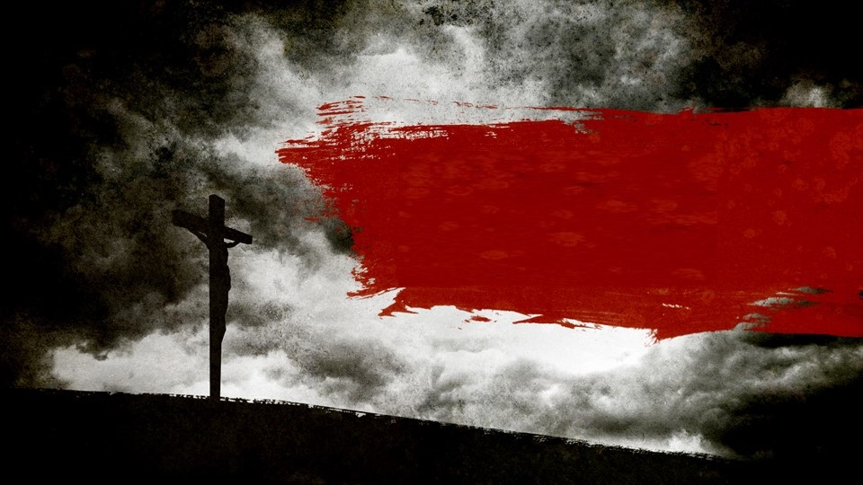
Reconciliation
Romans 5:6-9

Slide 2
Man is without strength
6 For when we were still without strength, in due time Christ died for the ungodly. 7 For scarcely for a righteous man will one die; yet perhaps for a good man someone would even dare to die.
Romans 5:6-7
Man’s weakness

Slide 3
Man is without strength
As a father pities his children, So the Lord pities those who fear Him. 14 For He knows our frame; He remembers that we are dust.
Psalms 103:13-14
Man’s weakness

Slide 4
But God…
8 But God demonstrates His own love toward us, in that while we were still sinners, Christ died for us.
Romans 5:8
Man’s weakness

Slide 5
Through Him
9 Much more then, having now been justified by His blood, we shall be saved from wrath through Him.
Romans 5:9
God’s strength

Slide 6
Reconciled
10 For if when we were enemies we were reconciled to God through the death of His Son, much more, having been reconciled, we shall be saved by His life. Romans 5:10
God’s strength

Slide 7
Christian have the best reason to by happy
11 And not only that, but we also rejoice in God through our Lord Jesus Christ…
Romans 5:11a
Reasons to Rejoice

Slide 8
We have now received reconciliation
…through whom we have now received the reconciliation.
Romans 5:11b
Reasons to Rejoice

Slide 9
We have now received reconciliation
13 But now in Christ Jesus you who once were far off have been brought near by the blood of Christ.
Ephesians 2:13
Reasons to Rejoice

Slide 10
1. Have you been reconciled to Christ?
2. Don’t wait to be brought back to God.
a. Do what is required by God before
it's too late.
Conclusion

