Slide 1
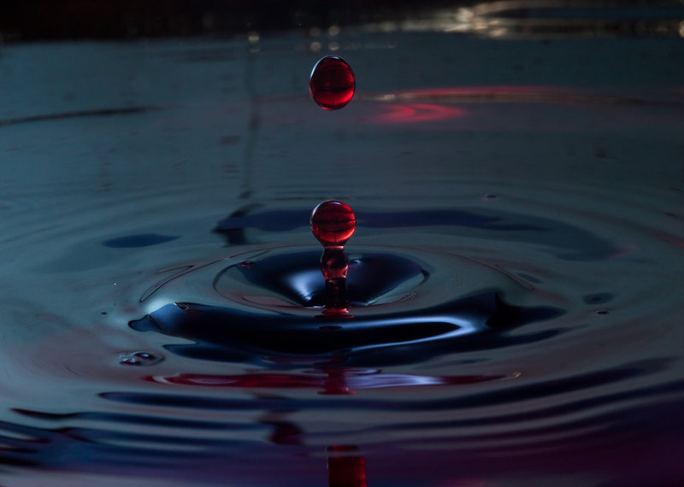
Exodus Lesson #4 Aaron’s Rod & the 1st Plague
Chapter 7

Slide 2
Exodus 7:1-7
So the Lord said to Moses:" See, I have made you as God to Pharaoh, and Aaron your brother shall be your prophet. 2 You shall speak all that I command you. And Aaron your brother shall tell Pharaoh to send the children of Israel out of his land. 3 And I will harden Pharaoh's heart, and multiply My signs and My wonders in the land of Egypt.

Slide 3
Exodus 7:1-7
But Pharaoh will not heed you, so that I may lay My hand on Egypt and bring My armies and My people, the children of Israel, out of the land of Egypt by great judgments. 5 And the Egyptians shall know that I am the Lord, when I stretch out My hand on Egypt and bring out the children of Israel from among them."6 Then Moses and Aaron did so; just as the Lord commanded them, so they did.

Slide 4
Exodus 7:1-7
7 And Moses was eighty years old and Aaron eighty- three years old when they spoke to Pharaoh.

Slide 5
God tells Moses His plan for Pharaoh
So the Lord said to Moses:" See, I have made you as God to Pharaoh, and Aaron your brother shall be your prophet. 2 You shall speak all that I command you. And Aaron your brother shall tell Pharaoh to send the children of Israel out of his land. 3 And I will harden Pharaoh's heart, and multiply My signs and My wonders in the land of Egypt.

Slide 6
God tells Moses His plan for Pharaoh
But Pharaoh will not heed you, so that I may lay My hand on Egypt and bring My armies and My people, the children of Israel, out of the land of Egypt by great judgments. 5 And the Egyptians shall know that I am the Lord, when I stretch out My hand on Egypt and bring out the children of Israel from among them."6 Then Moses and Aaron did so; just as the Lord commanded them, so they did.

Slide 7
God tells Moses His plan for Pharaoh
7 And Moses was eighty years old and Aaron eighty- three years old when they spoke to Pharaoh.

Slide 8
God & the rod of Aaron
Then the Lord spoke to Moses and Aaron, saying, 9 "When Pharaoh speaks to you, saying, ' Show a miracle for yourselves,' then you shall say to Aaron, ' Take your rod and cast it before Pharaoh, and let it become a serpent. '" 10 So Moses and Aaron went in to Pharaoh, and they did so, just as the Lord commanded. And Aaron cast down his rod before Pharaoh and before his servants, and it became a serpent.

Slide 9
God & the rod of Aaron
But Pharaoh also called the wise men and the sorcerers; so the magicians of Egypt, they also did in like manner with their enchantments. 12 For every man threw down his rod, and they became serpents. But Aaron's rod swallowed up their rods. 13 And Pharaoh's heart grew hard, and he did not heed them, as the Lord had said.

Slide 10
Moses speaks to Pharaoh
So the Lord said to Moses:" Pharaoh's heart is hard; he refuses to let the people go. 15 Go to Pharaoh in the morning, when he goes out to the water, and you shall stand by the river's bank to meet him; and the rod which was turned to a serpent you shall take in your hand. 16 And you shall say to him, "The Lord God of the Hebrews has sent me to you, saying, 'Let My people go, that they may serve Me in the wilderness"; but indeed, until now you would not hear!

Slide 11
Moses speaks to Pharaoh
17 Thus says the Lord:"By this you shall know that I am the Lord. Behold, I will strike the waters which are in the river with the rod that is in my hand, and they shall be turned to blood. 18 And the fish that are in the river shall die, the river shall stink, and the Egyptians will loathe to drink the water of the river." '"

Slide 12
God turns water into blood
Then the Lord spoke to Moses, " Say to Aaron, ' Take your rod and stretch out your hand over the waters of Egypt, over their streams, over their rivers, over their ponds, and over all their pools of water, that they may become blood. And there shall be blood throughout all the land of Egypt, both in buckets of wood and pitchers of stone.

Slide 13
God turns water into blood
20 And Moses and Aaron did so, just as the Lord commanded. So he lifted up the rod and struck the waters that were in the river, in the sight of Pharaoh and in the sight of his servants. And all the waters that were in the river were turned to blood. 21 The fish that were in the river died, the river stank, and the Egyptians could not drink the water of the river. So there was blood throughout all the land of Egypt.

Slide 14
God turns water into blood
Then the magicians of Egypt did so with their enchantments; and Pharaoh's heart grew hard, and he did not heed them, as the Lord had said. 23 And Pharaoh turned and went into his house. Neither was his heart moved by this. 24 So all the Egyptians dug all around the river for water to drink, because they could not drink the water of the river. 25 And seven days passed after the Lord had struck the river.

Slide 15
God of the Nile
1. By striking the Nile river God attacks one of the God’s of Egypt. The Nile river was one of their many gods (God would attack each one with each plague).
2. The Nile river was also called Hapi.
3. This god was pictured as holding a table on which are vases and flowers and fruit. This was to show that Hapi was the source of all good gifts.

Slide 16
God of the Nile
4. The Egyptians had a ‘Hymn of the Nile” which has this phrase “Thou art the Lord of the poor and the needy. If thou wert overthrown in the heavens the gods would fall upon their faces and men would perish.”
5. This miracle did indeed demonstrate the fall of Hapi. Thus this Egyptian god was no match for the One True God.

Slide 17
Lessons for us today.
God has revealed His reveal for us today also, through the New Testament.
God will deal with the wicked.

Slide 18
Conclusion
Today, we must believe in God’s power to save us from eternal damnation, if we follow Him.
Have you put your faith in Him?

